Slide 1
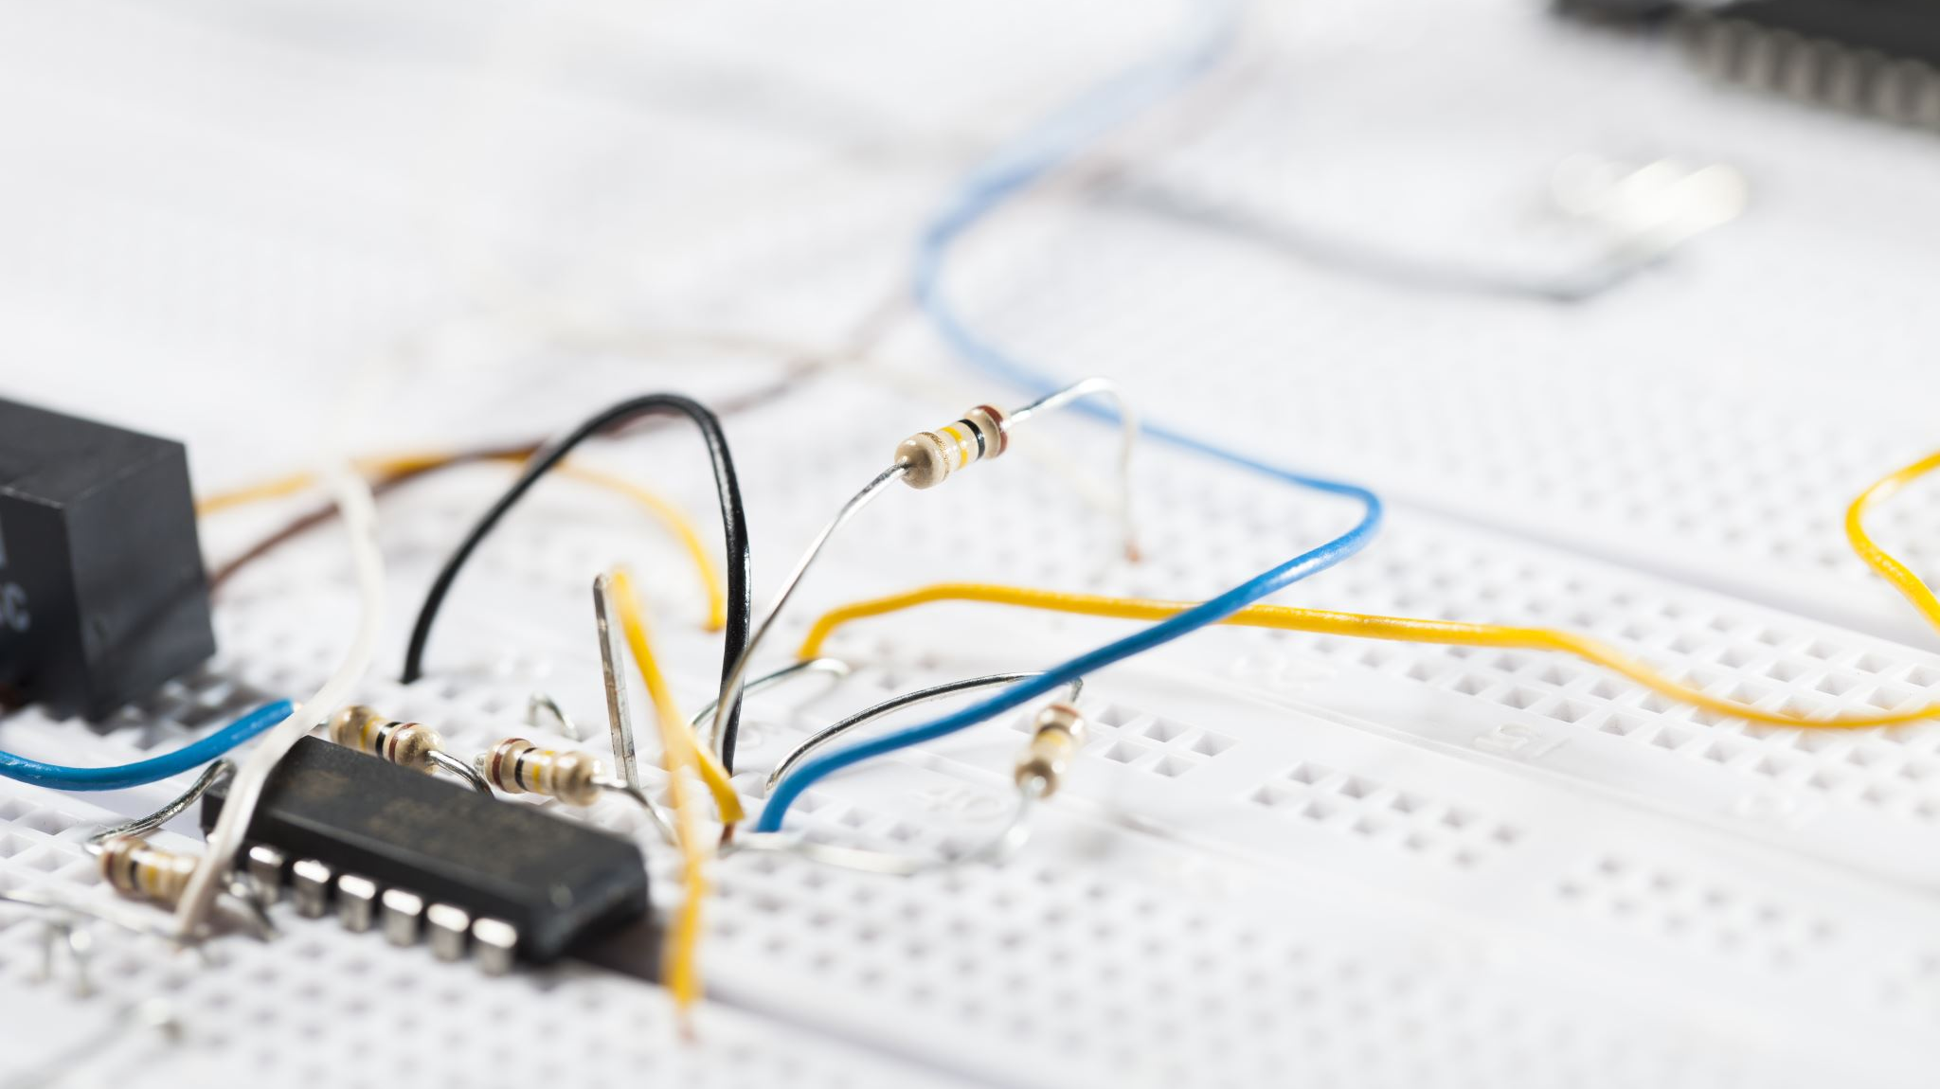
Programming the Arduino
Introduction

Slide 2

Introduction
Program Arduino using C++.
Programs commonly referred to as “sketches”
Some similarities to Java
Variables, if, for, while….
Reuse what you cover in Programming
We’ll do a quick overview of basics

Slide 3
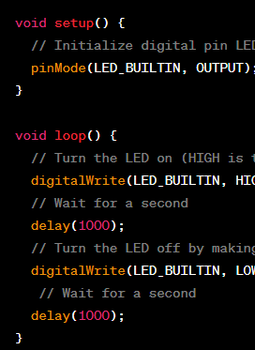
Program Structure
Sketches include setup() and loop() function
Setup()
Used to initialise stuff
Loop()
runs continuously, getting input from sensors etc.

Slide 4

Variables
Declare and initialise variables
Types of variables:
int, float, char, String, etc.
Variables declared inside function are only available inside that function

Slide 5
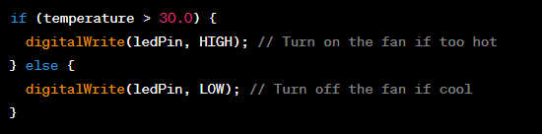
If Statements
Use if to make decisions based on conditions.
Example: use if statements to control Arduino pins.

Slide 6
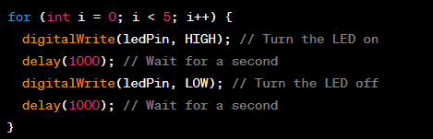
For Statements
Use for loops for repetition and iteration.
Example: blinking an LED multiple times.

Slide 7
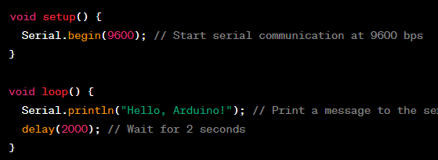
Serial Monitor
Serial Monitor can be used for debugging and communication between your computer(or other device) and the Arduino.
Initialise serial communication with Serial.begin(9600)
“9600” is the baud rate
Send data to the Serial Monitor with Serial.println() or Serial.print().

Slide 8

Analogue Read and Write
Use analogRead(pin) to read from analog pins.
Control output with analogWrite(pin, value) for PWM on digital pins.

Slide 9
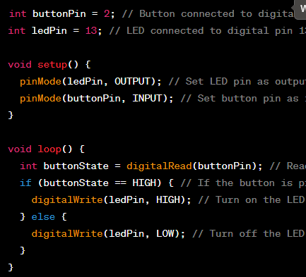
Digital Read and Write
Digital pins can be set high/low
Use digitalWrite(pin, HIGH/LOW) to set pin states.
Readi digital pin state with digitalRead(pin).

Slide 10
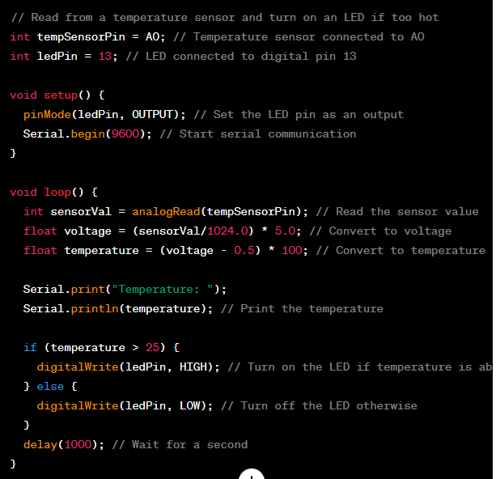
Example: Reading a Sensor and Control an LED

